Slide 1
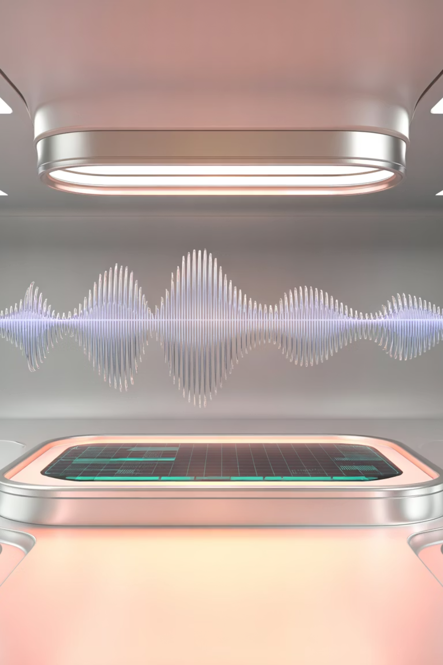
AI Automated Podcast Transcript
End-to-End AI System for Podcast Transcription and Clinical Analysis
by Kalyani J Ramayane.

Slide 2


HEALTHCARE INNOVATION
problem statement
Manual Transcription Bottlenecks
Clinical Insight Extraction
Healthcare providers face time-consuming manual transcription of medical podcasts, patient consultations, and clinical audio content. The process is labor-intensive and prone to errors.
Extracting actionable insights, identifying key medical topics, and generating comprehensive summaries from audio content manually is challenging and resource-intensive for healthcare teams.

Slide 3










Project Objectives
Accurate Transcription
Sentiment Analysis
Keyword Intelligence
Convert medical audio into precise, automated transcripts with clinical terminology recognition
Perform segment-level sentiment analysis to understand emotional context and patient interactions
Extract medical keywords and generate visual keyword clouds for quick topic identification
Clinical Summaries
Interactive Interface
Generate automated clinical summaries from medical dataset audio using advanced NLP models
Provide an intuitive UI for audio upload, segment navigation, and results visualization

Slide 4





SYSTEM WORKFLOW
Our Methodology
Audio Upload & Preprocessing
Users upload podcast or medical audio files which undergo quality enhancement and format normalization
Speech-to-Text Transcription
OpenAI Whisper converts audio into accurate text transcripts with timestamp segmentation
NLP Analysis Pipeline
Text processing, topic segmentation, sentiment analysis, and keyword extraction using NLTK and SpaCy
Clinical Summary Generation
Advanced NLP models generate comprehensive clinical summaries tailored for healthcare applications
Interactive Visualization
Streamlit UI presents results with keyword clouds, sentiment graphs, and navigable transcript segments

Slide 5






Powerful Technology Stack
Core Development
Speech Recognition
Python for backend processing
OpenAI Whisper for advanced ASR
Librosa & PyDub for audio preprocessing
Medical terminology optimization
JSON for data storage and management
Multi-accent support and accuracy
NLP & Analysis
Visualization
NLTK & SpaCy for text processing
Streamlit for interactive UI
TF-IDF for keyword extraction
Plotly for dynamic charts
VADER and transformers for sentiment
WordCloud for keyword visualization

Slide 6
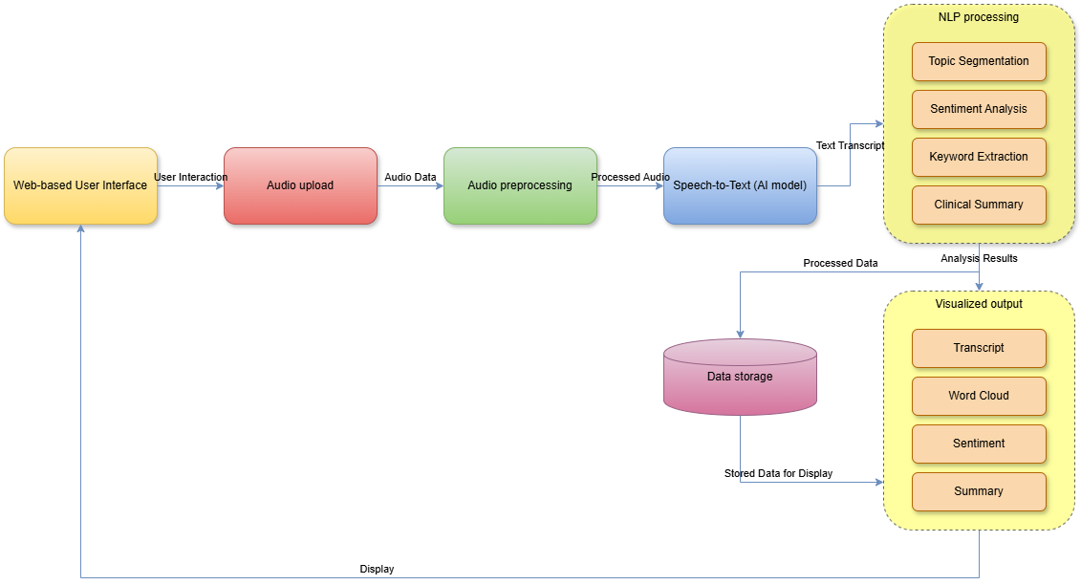
System Architecture
Our end-to-end pipeline seamlessly integrates audio processing, AI transcription, NLP analysis, and clinical summarization into a unified, healthcare-focused platform.

Slide 7

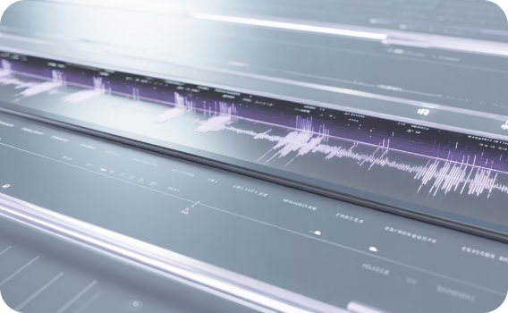
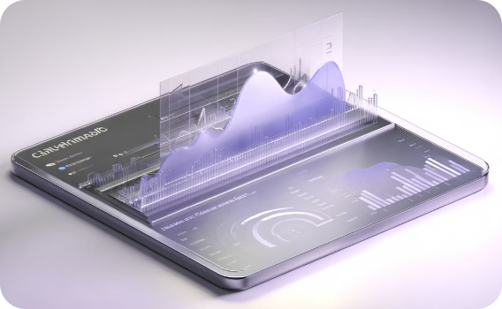

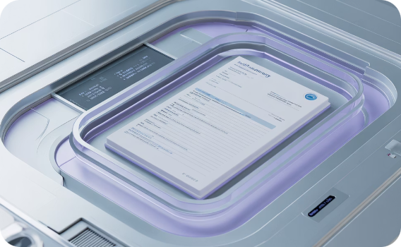
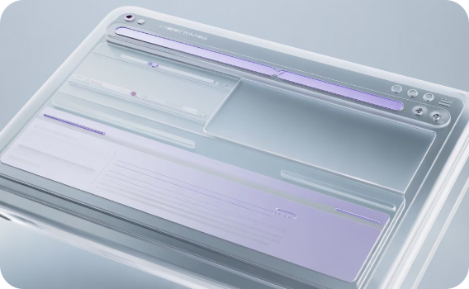
KEY FEATURES
What Makes Our Solution Stand Out
Automatic Audio Transcription
Segment-Level Sentiment Analysis
Keyword Cloud Visualization
Clinical Summary Generation
State-of-the-art ASR technology delivers accurate transcripts with medical terminology recognition and timestamp precision
Understand emotional context throughout conversations with detailed sentiment tracking per transcript segment
Instantly identify key topics and medical terms through visually engaging keyword clouds and tag extraction
AI-powered summaries specifically tailored for medical audio, extracting critical clinical information automatically
Interactive Streamlit Interface
User-friendly UI enables easy audio upload, segment navigation, and comprehensive results exploration

Slide 8

Real-World Impact
85%
Time Savings
Reduction in manual transcription effort for healthcare teams
95%
Accuracy Rate
Clinical transcription accuracy with Whisper ASR technology
3x
Faster Insights
Speed improvement in extracting actionable clinical insights

Slide 9
Future Roadmap & Enhancements
Real-Time Transcription
1
Extend capabilities to live podcast and consultation transcription with minimal latency
2
Multi-Language Support
Add transcription and analysis for multiple languages to serve diverse healthcare environments
Domain-Specific Models
3
Improve clinical summary accuracy using specialized medical NLP and fine-tuned language models
4
Emotion Recognition
Integrate speech emotion recognition for deeper patient interaction insights
Analytics Dashboard
5
Build comprehensive analytics for processing and analyzing large-scale medical audio datasets

Slide 10
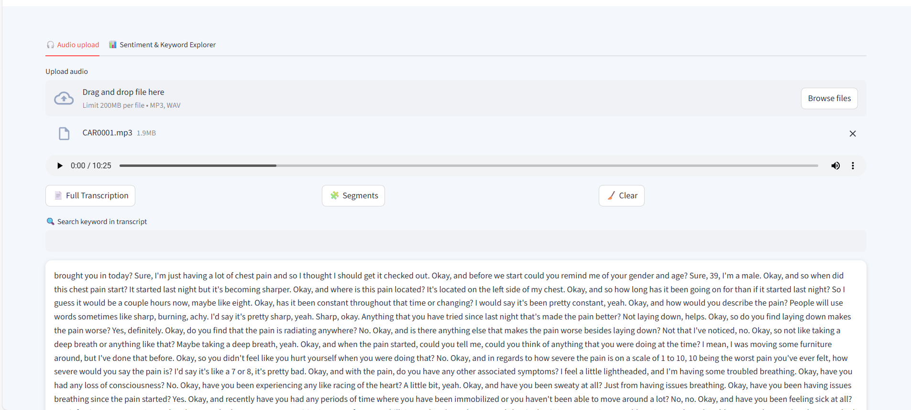
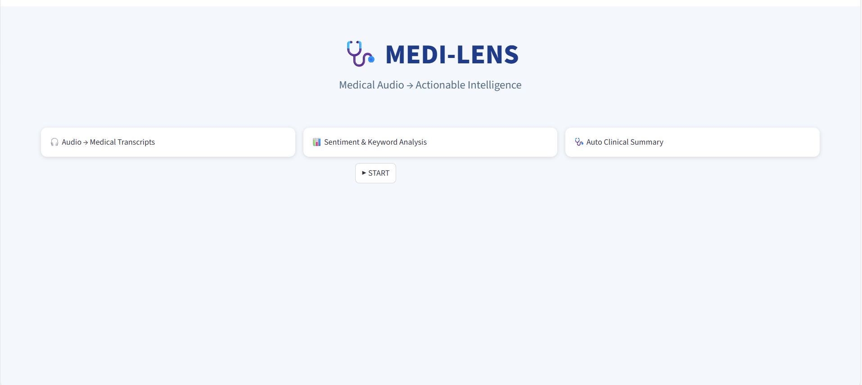
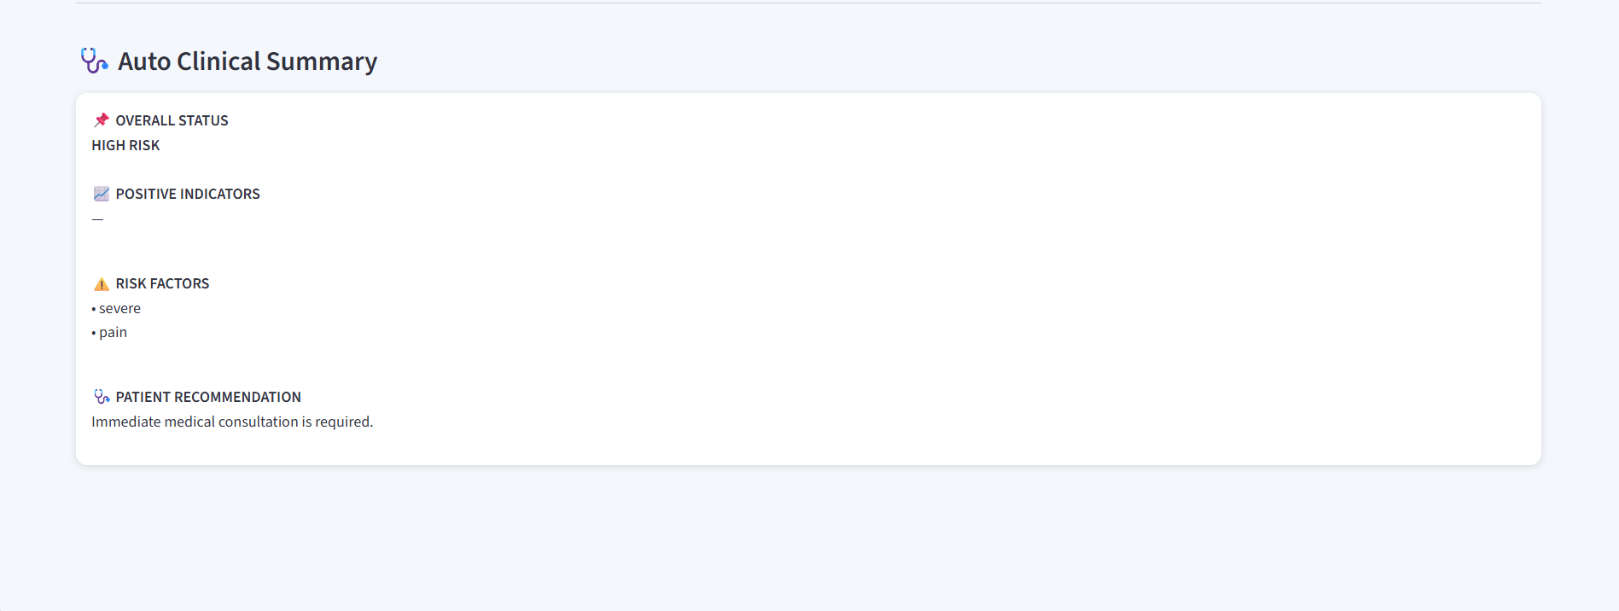
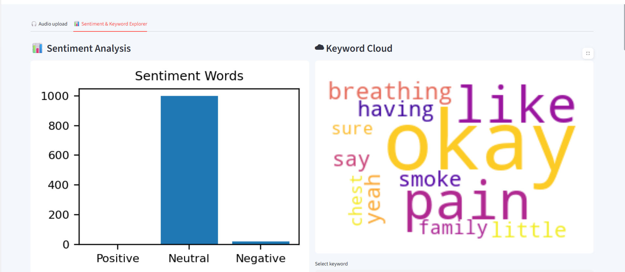
System Demonstration
Key References & Technologies
OpenAI Whisper — Advanced ASR
Streamlit — Interactive UI framework
Librosa — Audio processing
WordCloud — Keyword visualization
NLTK — Natural language toolkit
Matplotlib — Data visualization
Scikit-learn — Machine learning
Speech & Language Processing — Reference

Slide 11


